Slide 1
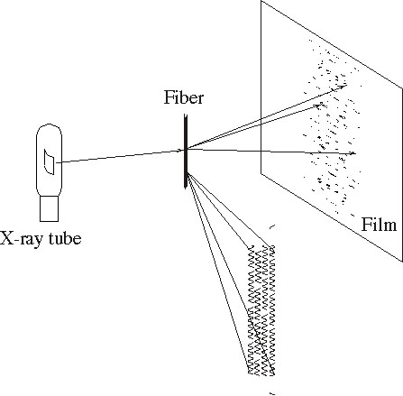
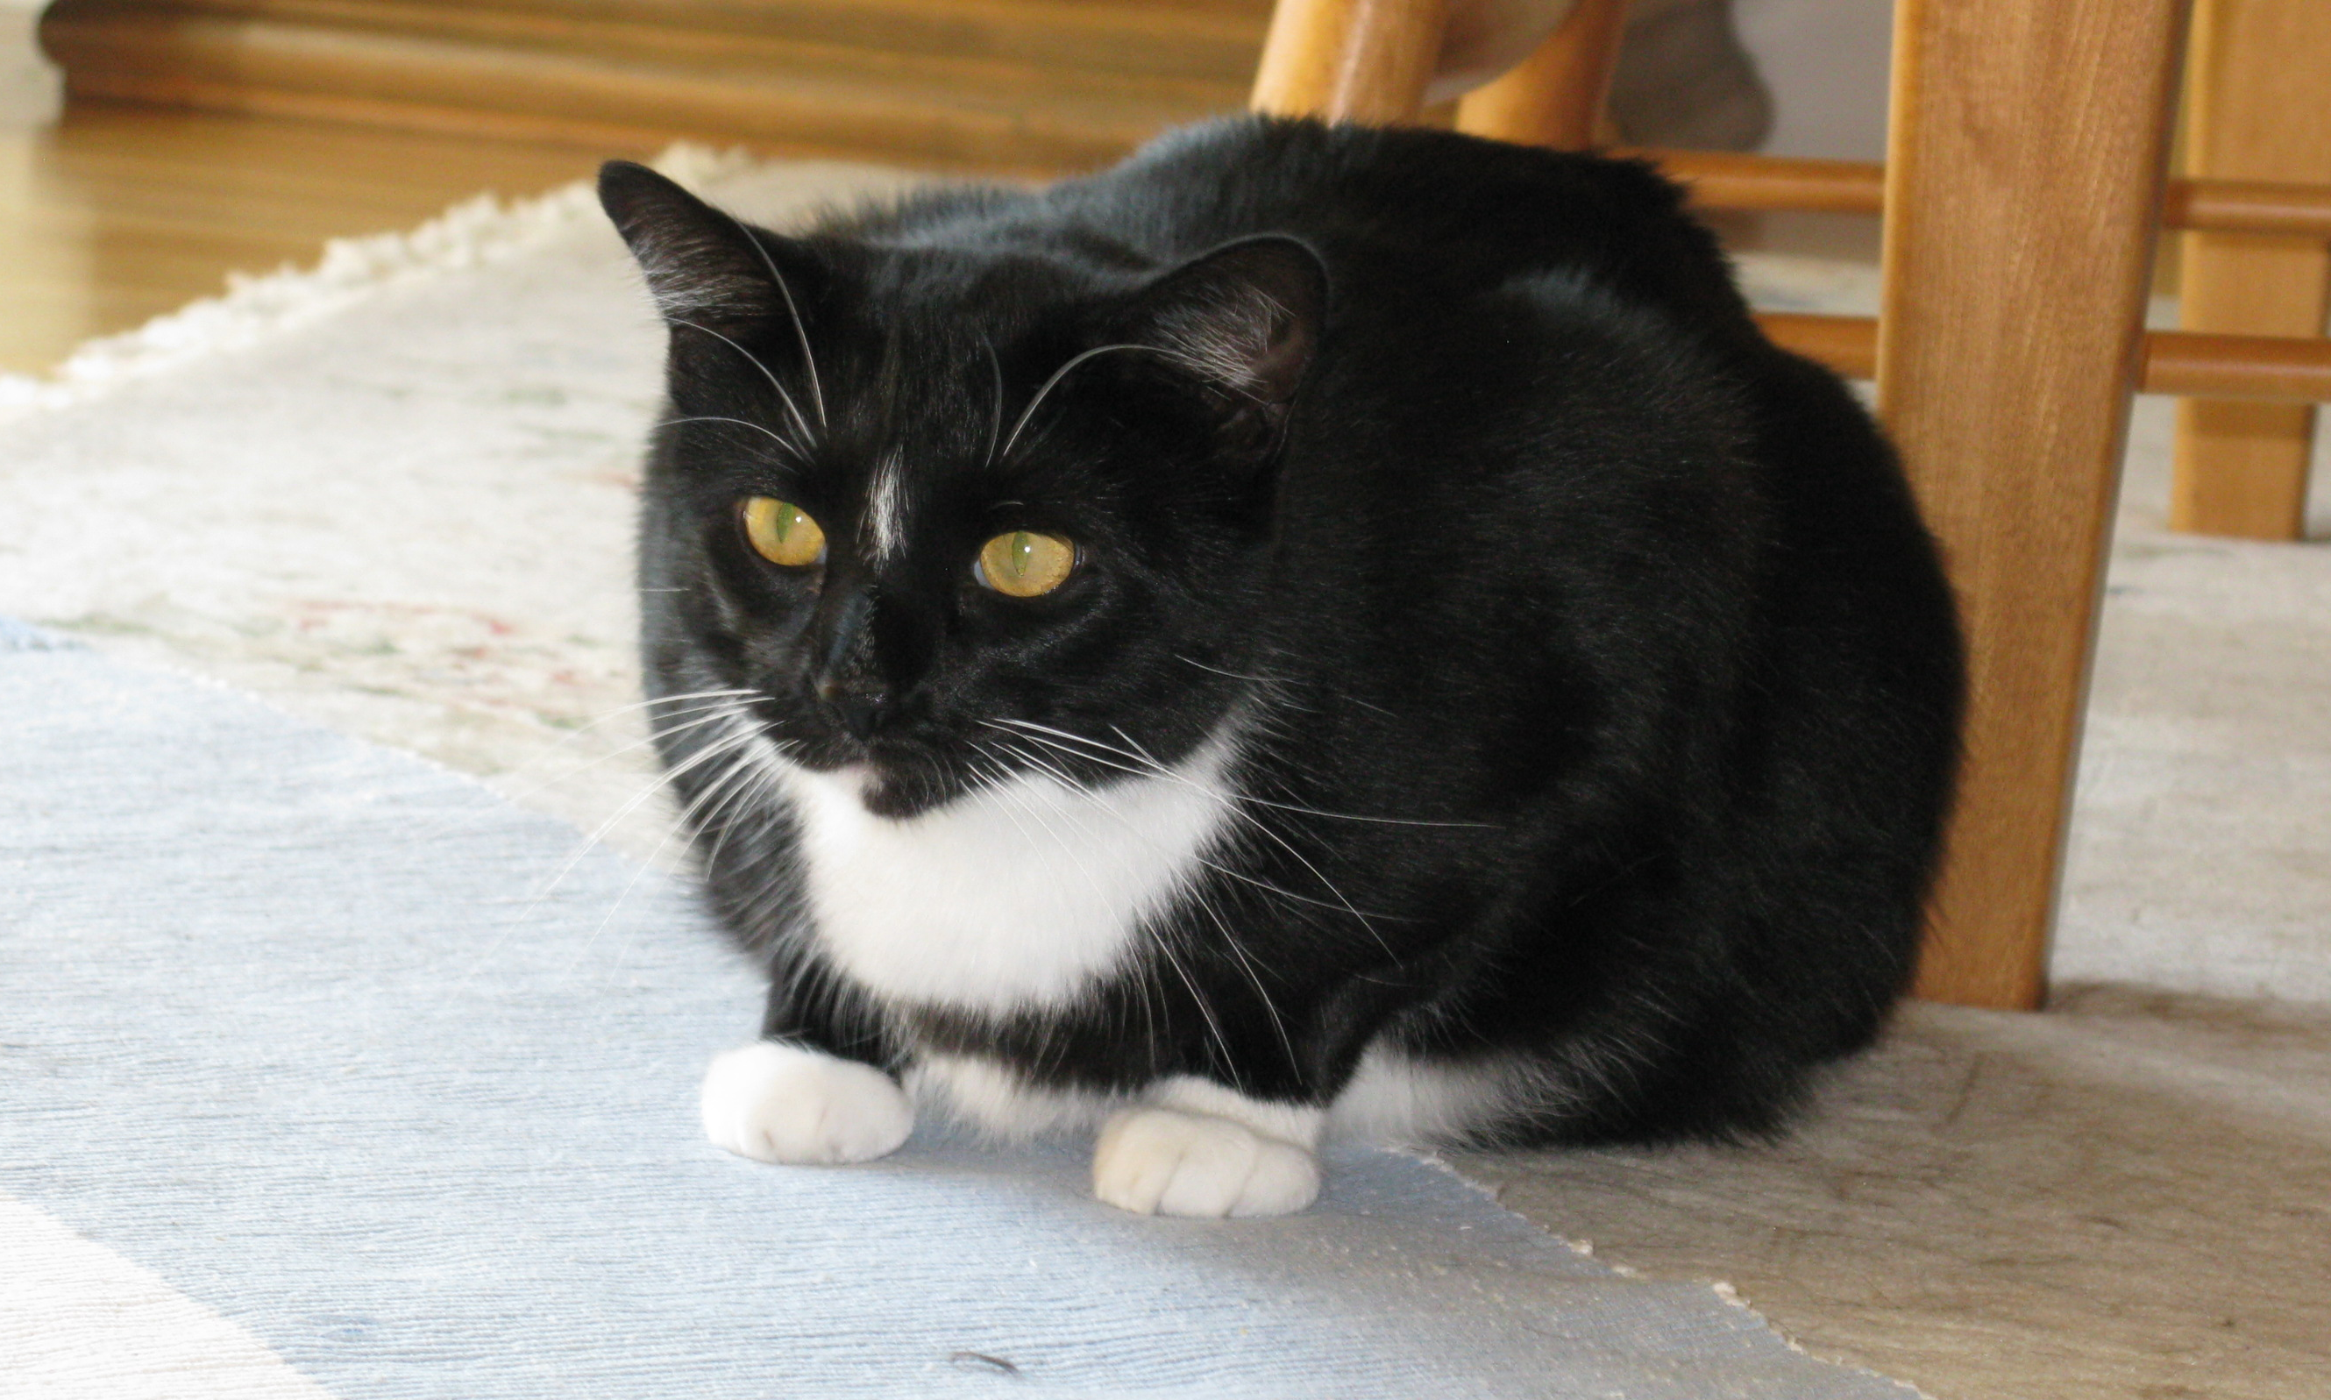
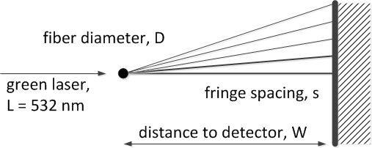
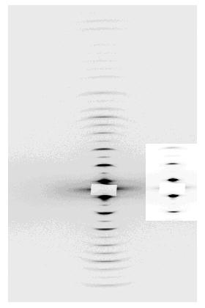
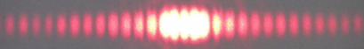
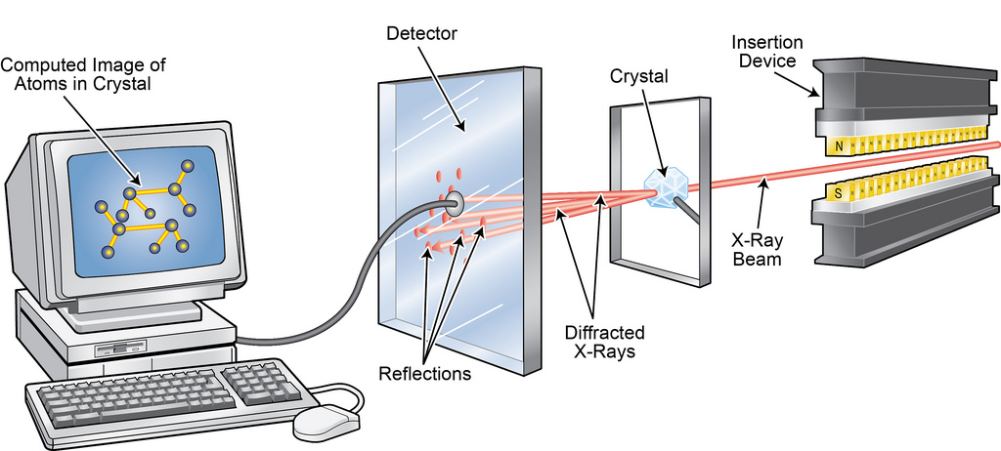
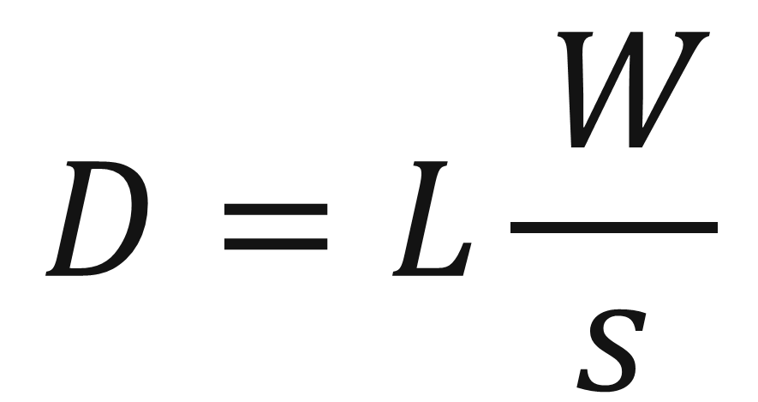
Fiber Diffraction from a Cat’s Whisker
Pete R. Jemian, Tom Walsh, Advanced Photon Source, Argonne National Laboratory
2013-04-26: Career Fair 2013, Minooka Junior High School, Minooka, IL
Abstract
What can we learn about a cat’s whisker with a simple alignment laser? With a few extra tools to hold things steady, we can measure interference fringes and calculate the diameter of the whisker.
Schematic
We’ll use a
whiteboard
The Donor
We’ll use a
green laser
532 nm wavelength
Math (theory omitted)
Note: The whisker was obtained from the carpet, not directly from the cat. Never do that.
$$D=L\frac{ W}{s}$$
Geometry
red laser
L = 635 nm
For Reference
X-ray diffraction from a fiber of chicken leg tendon. The fringe spacing is due to crystal dimensions in the tendon.
Similar setup for X-ray Diffraction
A high-intensity X-ray source is used, the rest is familiar.
Conclusion
With simple tools and scientific principles, we can investigate and understanding more of the world around us.
The Advanced Photon Source is an Office of Science User Facility operated for the U.S. Department of Energy Office of Science by Argonne National Laboratory

